Slide 1
CGB1221 – DATABASE MANAGEMENT SYSTEMS PROJECT REVIEW-2
Artificial Intelligence
Academic Year: 2024 – 2025 (Even Semester)
Register Number : 927623BAD086
Name : PRIYANKA P
Year : II
Semester : IV
Section : B
Date : 12.05.2025

Slide 2
Title of the Project
Employee Attendance and Leave Approval System

Slide 3
Abstract
The Employee Attendance and Leave Management System is a web-based platform to manage employee attendance, leave requests, and notifications. Employees can check-in, check-out, and apply for leaves, while admins can manage records and approve or reject requests. Approved leaves automatically update attendance as "On Leave." Built using PHP, MySQL, HTML, and CSS, the system simplifies employee tracking, reduces manual errors, and improves overall management efficiency.

Slide 4
Abstract with CO/PO Mapping
Abstract | CO | POs | PSO
The Employee Attendance and Leave Management System is a web-based platform to manage employee attendance, leave requests, and notifications. Employees can check-in, check-out, and apply for leaves, while admins can manage records and approve or reject requests. Approved leaves automatically update attendance as "On Leave." Built using PHP, MySQL, HTML, and CSS, the system simplifies employee tracking, reduces manual errors, and improves overall management efficiency. | CO1 CO2 | PO 2 PO 5 PO 9 PO 11 | PSO1 PSO2

Slide 5
Introduction
The Employee Attendance and Leave Management System is designed to simplify and automate the process of managing employee attendance and leave requests.
Employees can easily check-in, check-out, and submit leave applications, while administrators can monitor attendance records, approve or reject leaves, and send notifications.
Developed using PHP, MySQL, HTML, and CSS, the system ensures efficient tracking, reduces manual errors, and enhances overall workforce management.

Slide 6
DBMS - Concepts Used
CRUD operations
Joins
Normalisation
Transactions
Relationship
Constraints

Slide 7
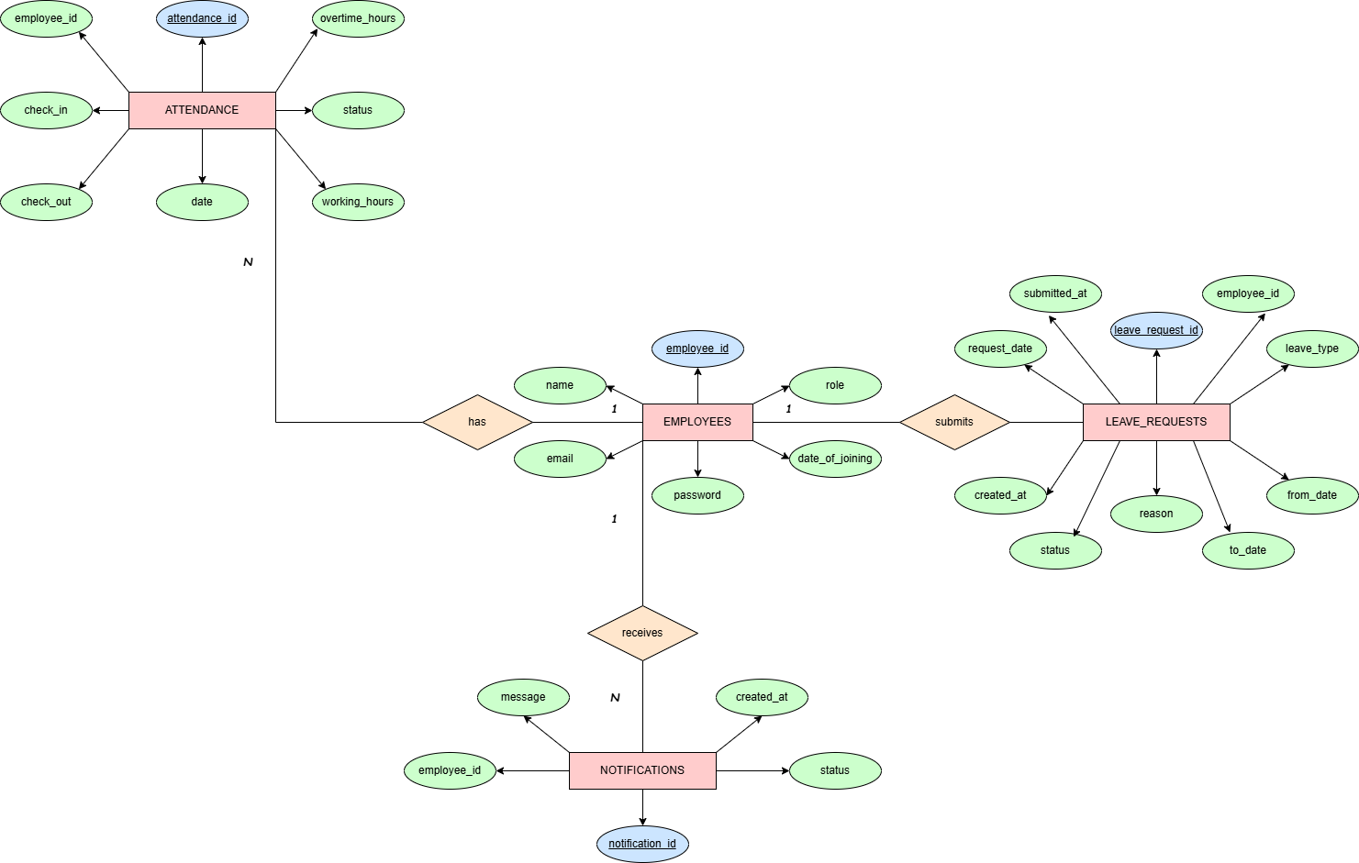
E-R DIAGRAM

Slide 8
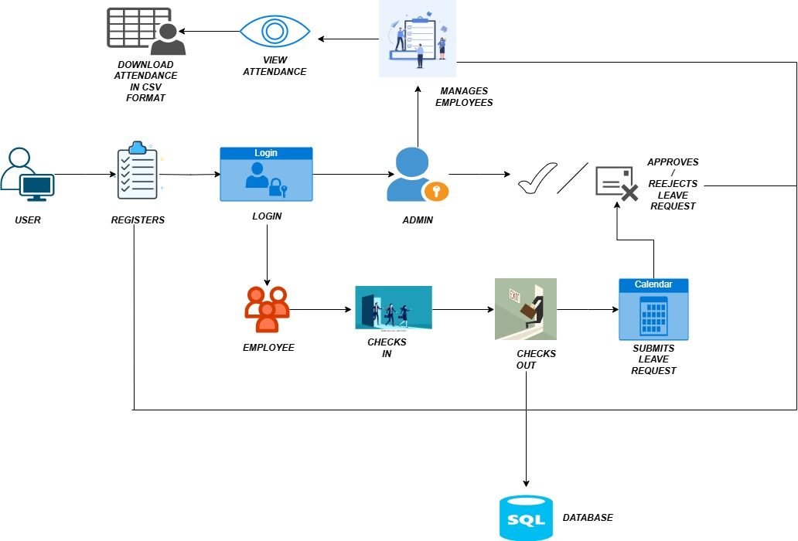
Proposed Architecture

Slide 9
Proposed Architecture - Description
User Registration & Login:
New users register via a form.
Based on login credentials, users are directed as Employee or Admin.
Employee Role:
Employees can check-in and check-out to mark their attendance.
They can also submit leave requests through a calendar interface.
Admin Role:
Admins manage employee records (add/update/delete).
They review submitted leave requests and approve or reject them.

Slide 10
Proposed Architecture - Description
Attendance Management:
Check-in and check-out data are recorded and stored in the database.
Approved leave requests can be reviewed in attendance reports.
Leave Management:
Employees submit leave requests specifying dates and reasons.
Admins handle approvals or rejections, and changes are reflected in the system.
Data Storage:
All records (users, attendance, leaves) are stored in a MySQL database.
Reports & Exports:
Attendance data can be viewed and exported in CSV format for reporting

Slide 11
List of Modules
User Authentication Module
Employee Management Module
Attendance Management Module
Leave Management Module
Notifications Module
Admin Dashboard Module
Export Module
Profile Management Module
Password Management Module

Slide 12
Module Description
🔹 User Authentication Module
Handles user registration, login, role-based access (Admin/Employee).
🔹 Employee Management Module
Allows admins to add, update, delete, and manage employee details.
🔹 Attendance Management Module
Employees can check-in and check-out daily; attendance is recorded.
🔹 Leave Management Module
Employees submit leave requests; admins can approve or reject them.

Slide 13
Module Description (Cont..)
Notifications Module
Sends important updates like leave approval/rejection to employees.
Admin Dashboard Module
Admin views summary counts like total employees, pending leaves, etc.
Export Module
Allows exporting employee attendance and leave data into CSV format.
Profile Management Module
Employees can view and update their profile details.
Password Management Module
Users can change their password or reset it if forgotten.

Slide 14
Software Specification (Tools / Programming Languages used)
Front-end:
HTML5
CSS3
Back-end:
PHP
My SQL

Slide 15
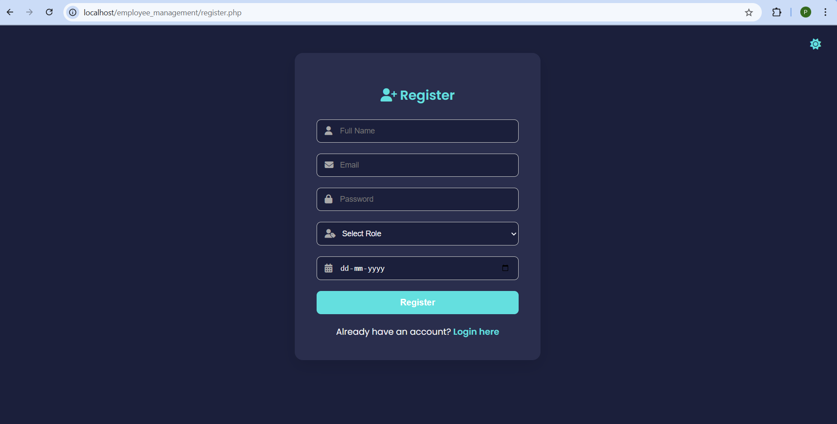
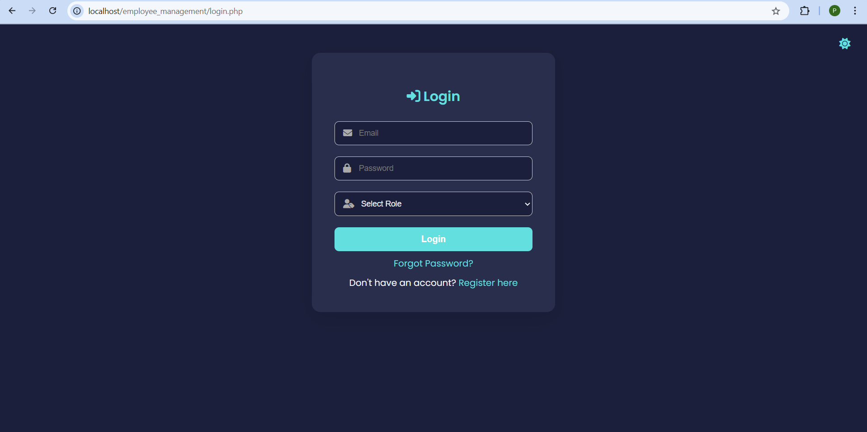
Sample Screen shot
REGISTER PAGE
LOGIN PAGE

Slide 16
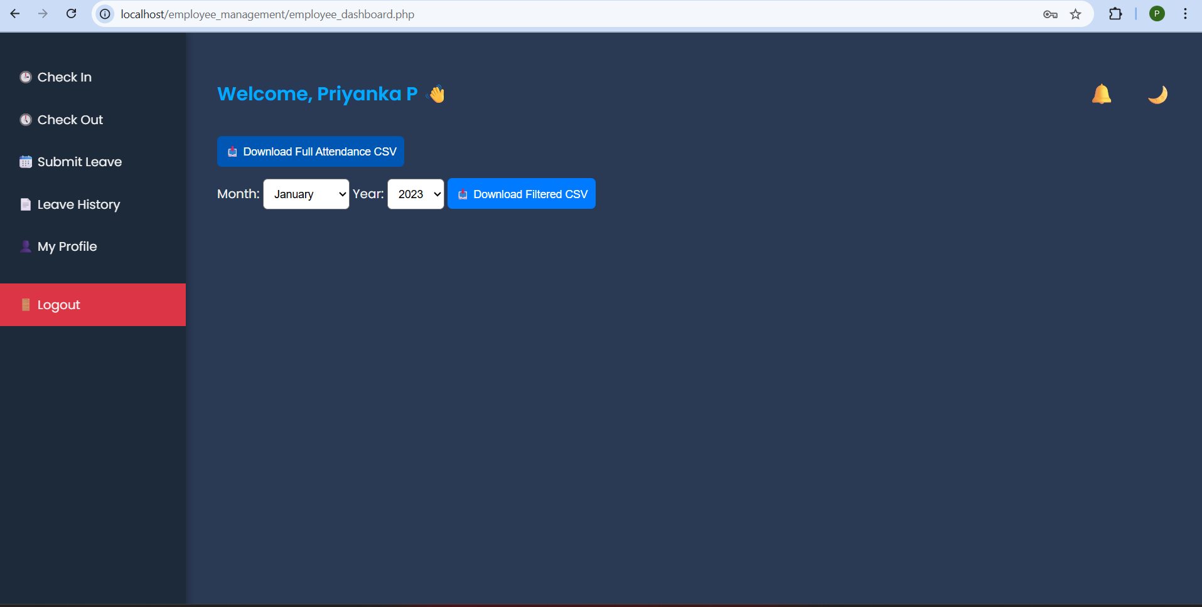
Sample Screen shot

Slide 17
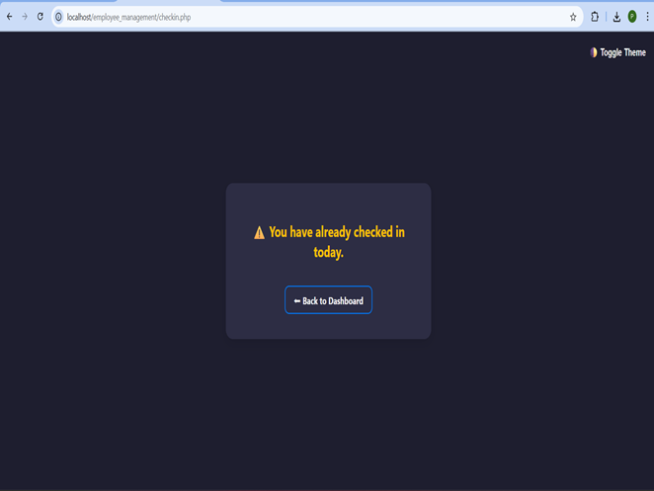
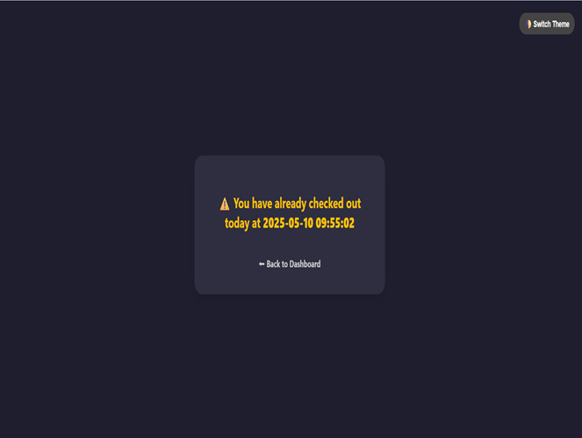
Sample Screen shot
CHECK- IN
CHECK-OUT

Slide 18
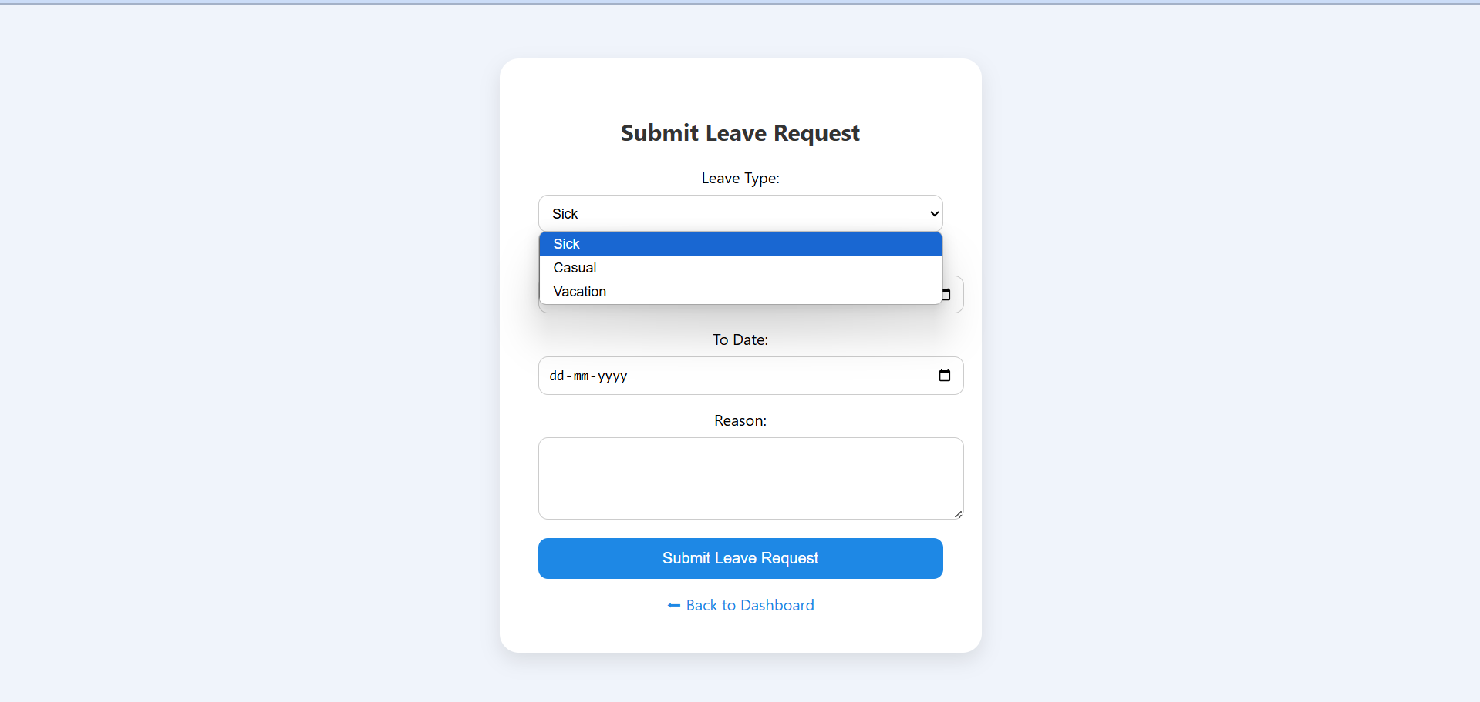
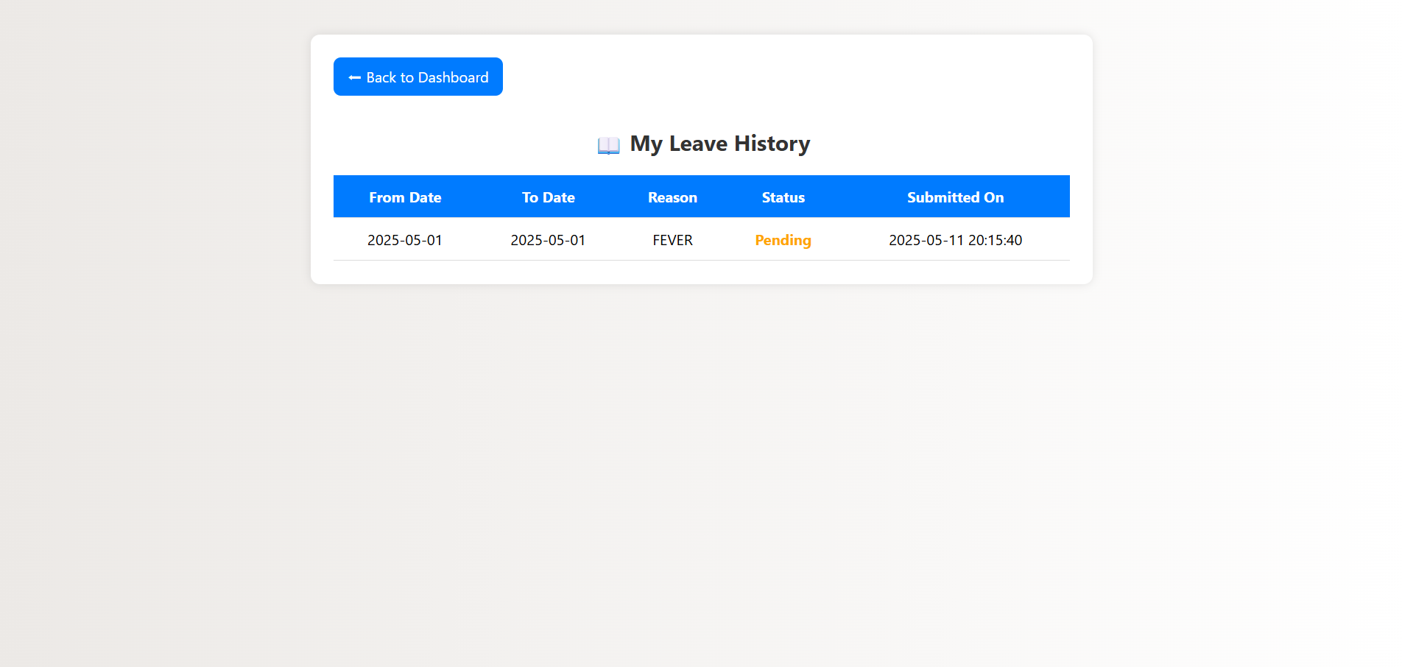
Sample Screen shot
LEAVE REQUEST
LEAVE HISTORY

Slide 19
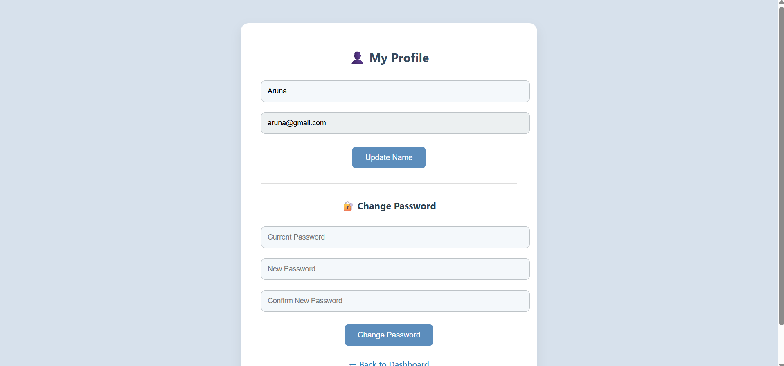
Sample Screen shot

Slide 20
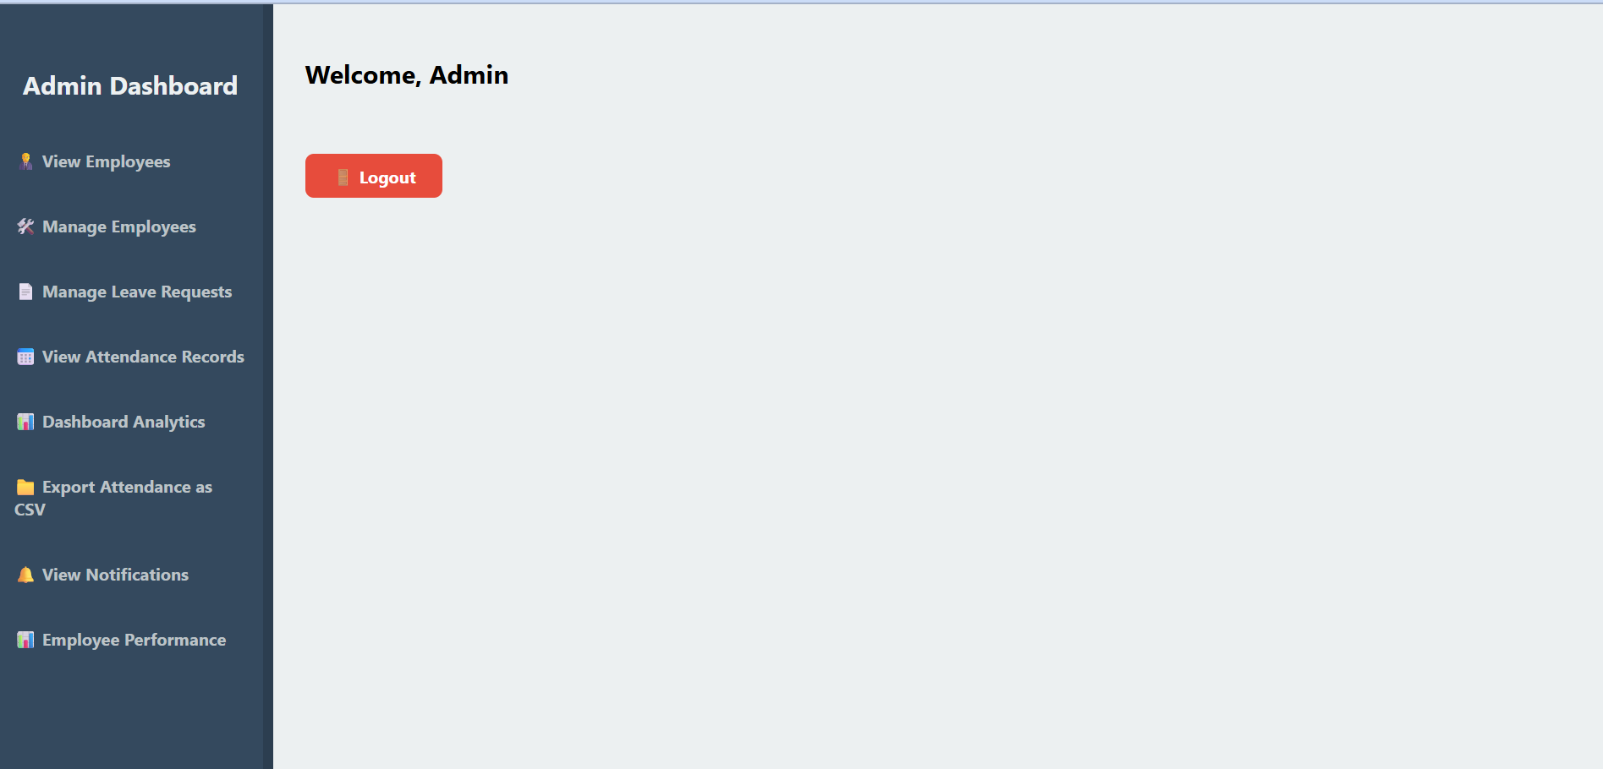
Sample Screen shot

Slide 21
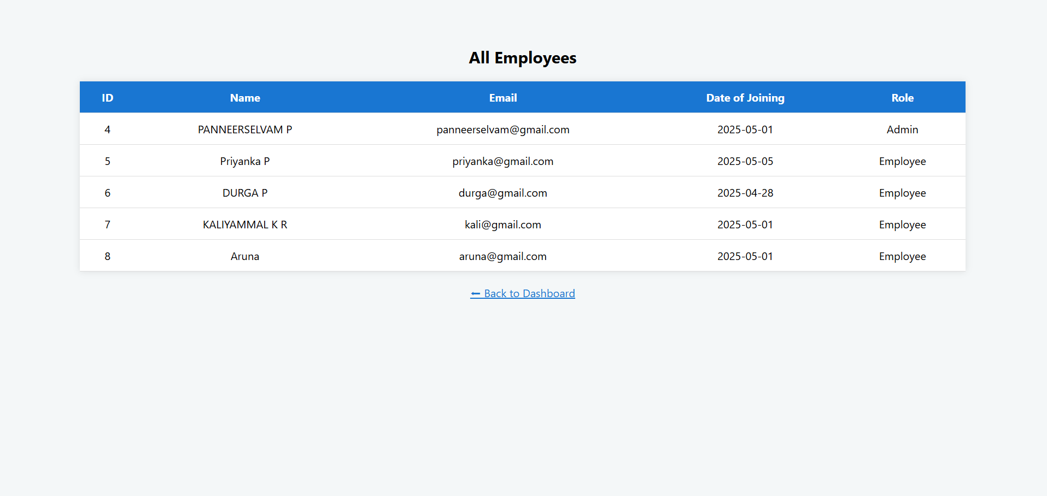
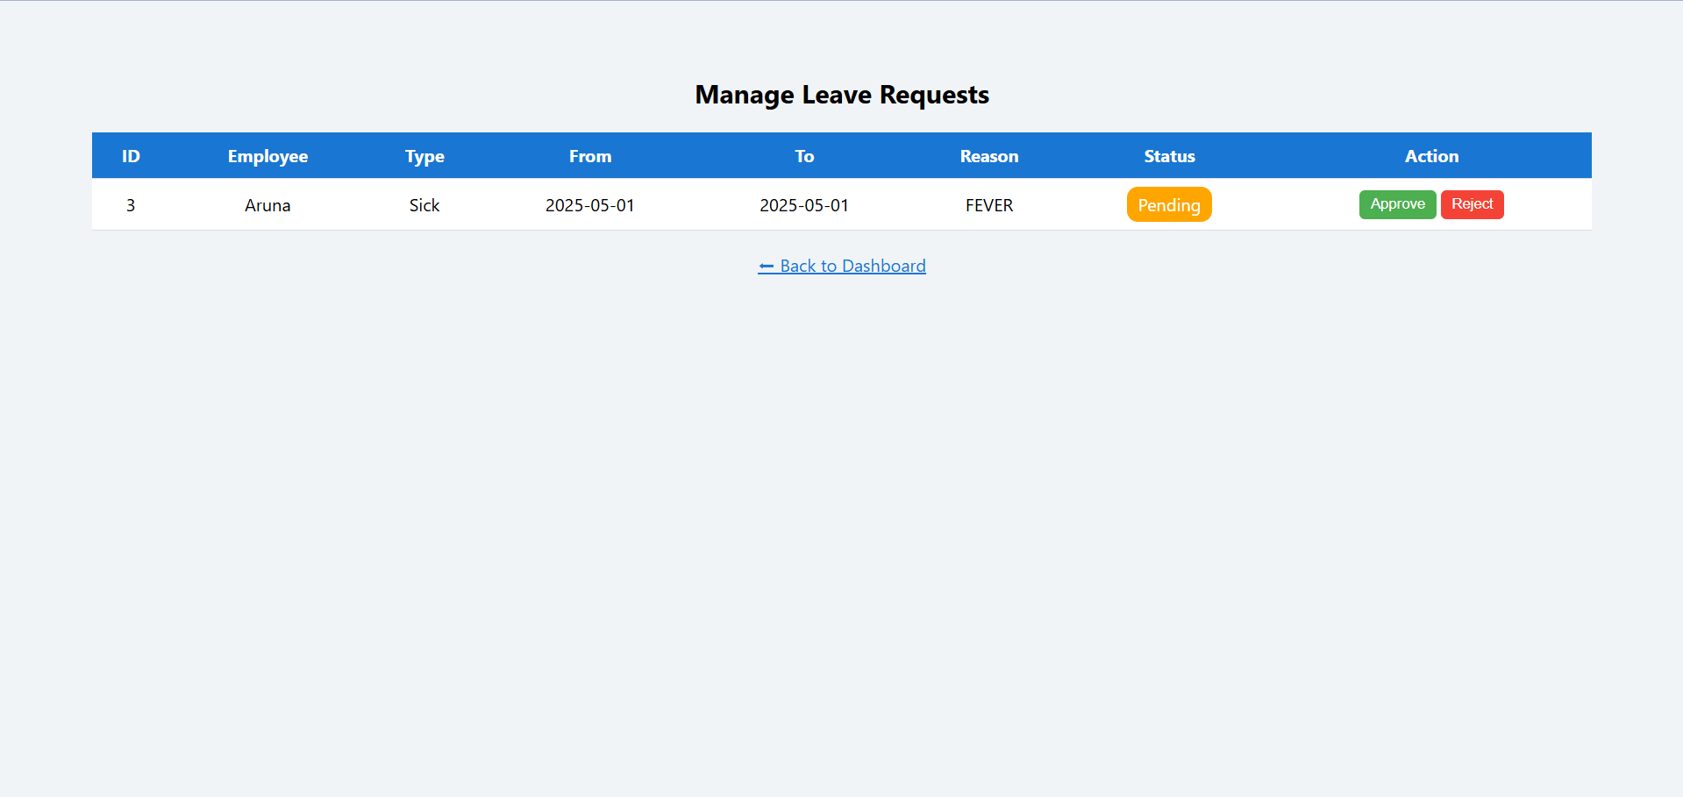
Sample Screen shot
VIEW EMPLOYEES
MANAGE LEAVE REQUESTS

Slide 22
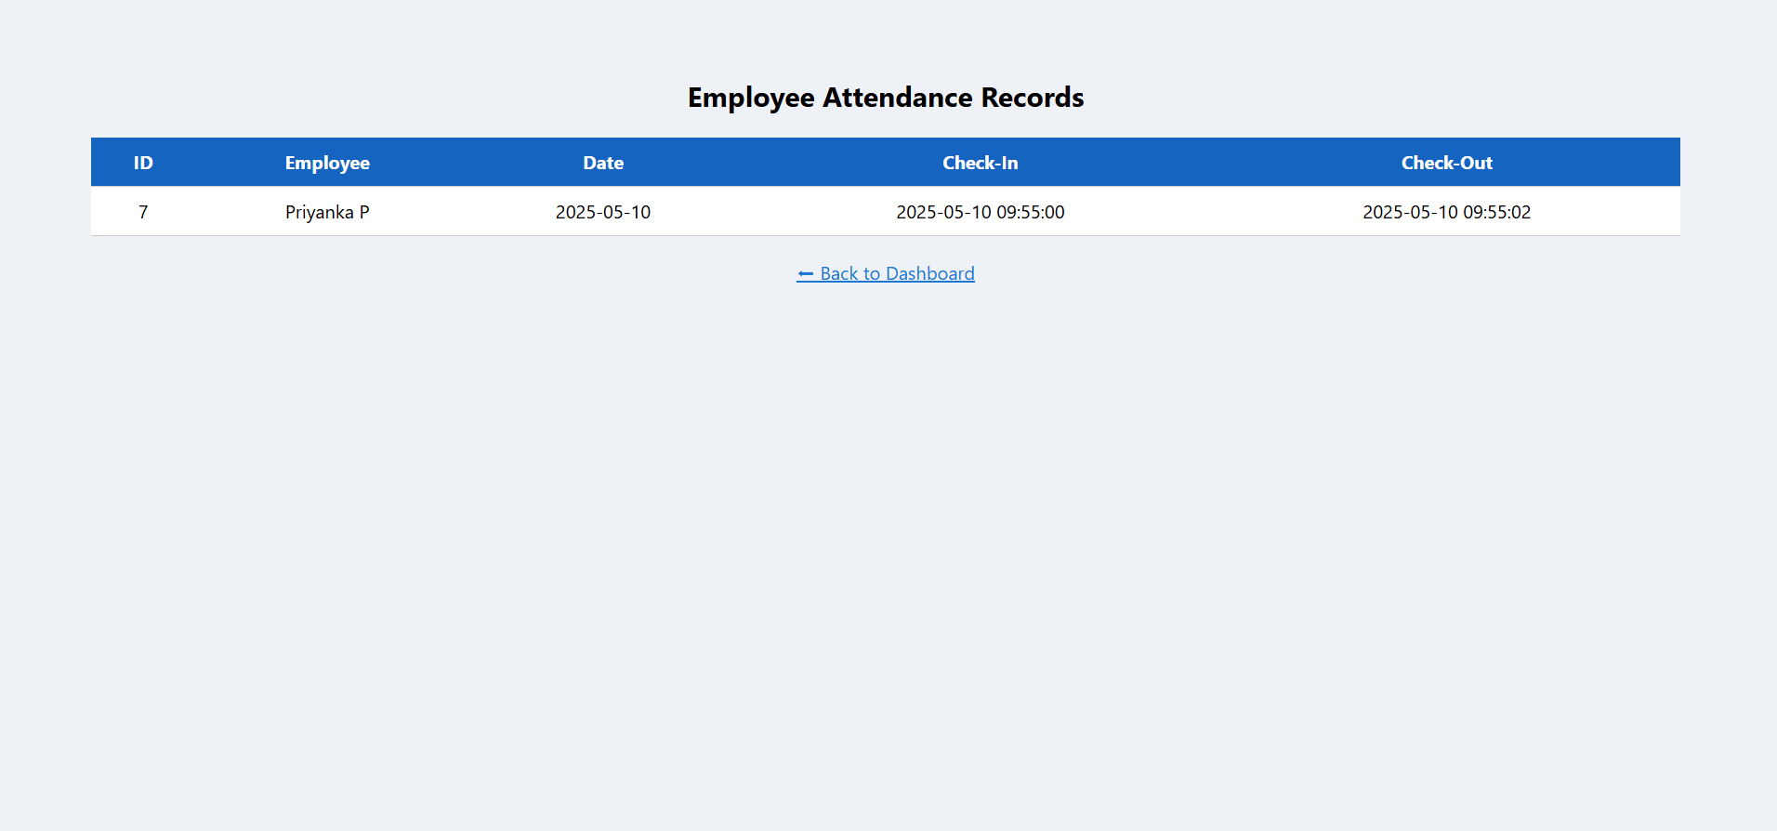
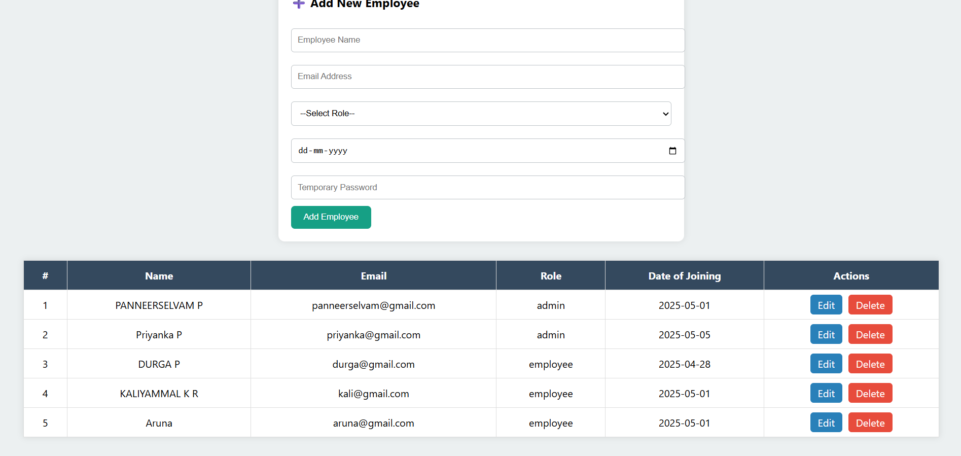
Sample Screen shot
EMPLOYEE ATTENDANCE RECORDS
MANAGE LEAVE REQUESTS

Slide 23
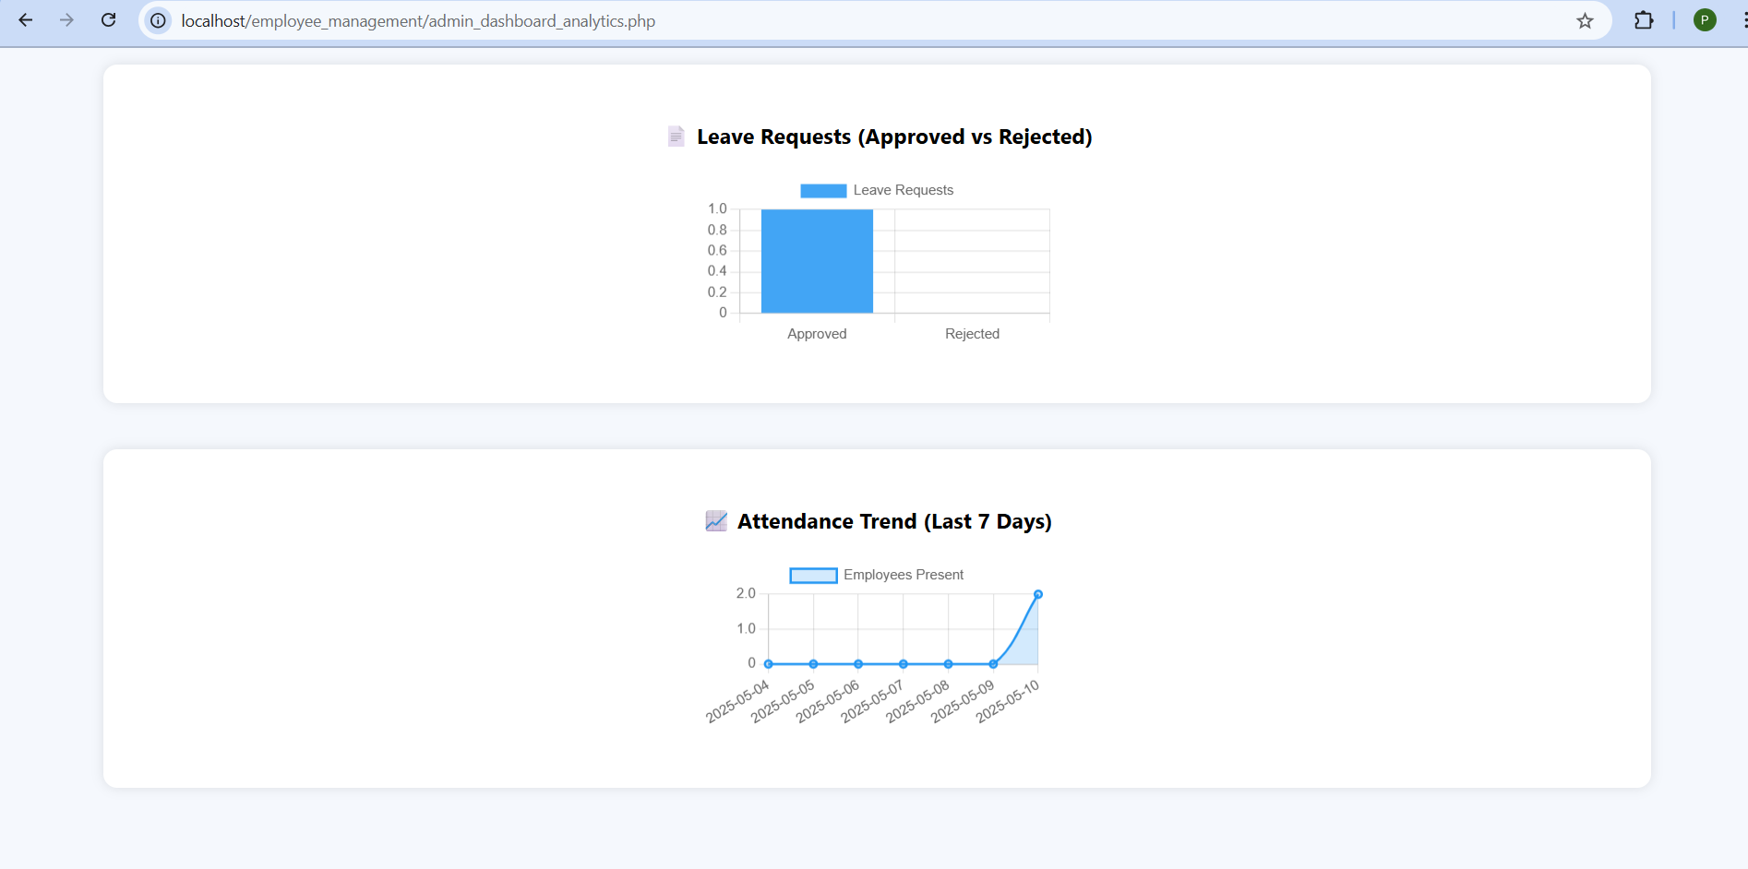
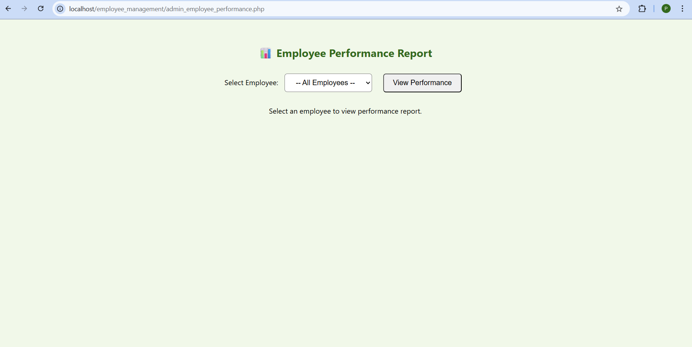
Sample Screen shot
DASHBOARD ANALYTICS
EMPLOYEE PERFORMANCE MODULE

Slide 24
Conclusion
The Employee Attendance and Leave Management System simplifies workforce tracking by providing a centralized platform for managing check-ins, check-outs, and leave requests. It enhances transparency between employees and administrators while improving record accuracy. With features like role-based access, notifications, and CSV export, the system ensures efficient attendance handling. Though auto-update for leave days is pending, the current modules offer a reliable and user-friendly solution for daily attendance and leave management.

Slide 25
Thank You
ANY QUERIES???

